Slide 1
Curriculum Night
2019-2020
WELCOME
Ms. Kristine Kelley
Fifth Grade Teacher
St. John School

Slide 2
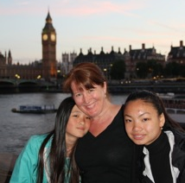
About me...
Ms. Kristine Kelley
My girls!
B.A. in History of Art from University of Michigan
(Go Blue!)
M.A. in Education from Eastern Michigan University
23 years as a 5th Grade teacher
13th year at St. John School
My husband and I have 2 daughters, Mimi is a 10th grader at Seattle Prep, Julia is a senior at Lakeside High School.

Slide 3
Specialists
Spanish Monday & Tuesday
P.E. Wednesday & Thursday
Music Wednesday & Thursday
Library Friday
Art Friday

Slide 4
Schoolwide Learning Expectations
We are CHRIST-CENTERED People
We are ACTIVE LISTENERS
We are EMPOWERED DISCIPLES
These targets will be identified in daily lessons, self-assessed by students, and evaluated by
teachers each throughout the year.
Aim for Soaring Eagle Awards!

Slide 5

Religion
Be Kind
Let us consider how we may spur one another toward love, kindness, and good deeds.” –Hebrews 10:24
Encourage your child to think of others
Daily prayer and reflection
7 sacraments-Spirit of Truth text
Call to service
  Altar service
  Ill and Homebound ministry
  St. Vincent de Paul food bank field trip

Slide 6
Reading
  Daily 5 & Literacy Cafe
  Novels for Curriculum Integration
    Pedro’s Journal by Pam Conrad
    Morning Girl by Michael Dorris
    The Watsons Go To Birmingham-1963 by Christopher Paul Curtis
    Colonial American Novels – Lit groups
    Non-Fiction Texts & Achieve 3000

Slide 7
English Language Arts
6 Traits of Effective Writing: Ideas, Organization, Voice, Word Choice, Sentence Fluency, Conventions
Persuasive, Narrative, Explanatory forms
Writing across the curriculum – polished, provisional, readable
Voyages in English – Writing and Grammar Text
Spelling/Vocabulary – online weekly tests at www.spellingcity.com

Slide 8
Mathematics
Go Math! Common Core edition
    Fractions and Decimals
    Logic puzzles galore
    Productive Math Talk
Math Olympiad – Starts October 18th!

Slide 9
Social Studies – U.S. History
  Exploration of the Americas - Galleon Simulation
  Colonial America - Colonial Boston: A Struggle for Independence Storypath
  US Geography
  Branches of the Government

Slide 10
Science
HMH Science Dimensions Text-Next Gen standards
Matter and Its Interactions
Motion and Stability
Molecules to Organisms
Earth and Human Activity
Ecosystems and Energy
Earth’s Place in the Universe

Slide 11

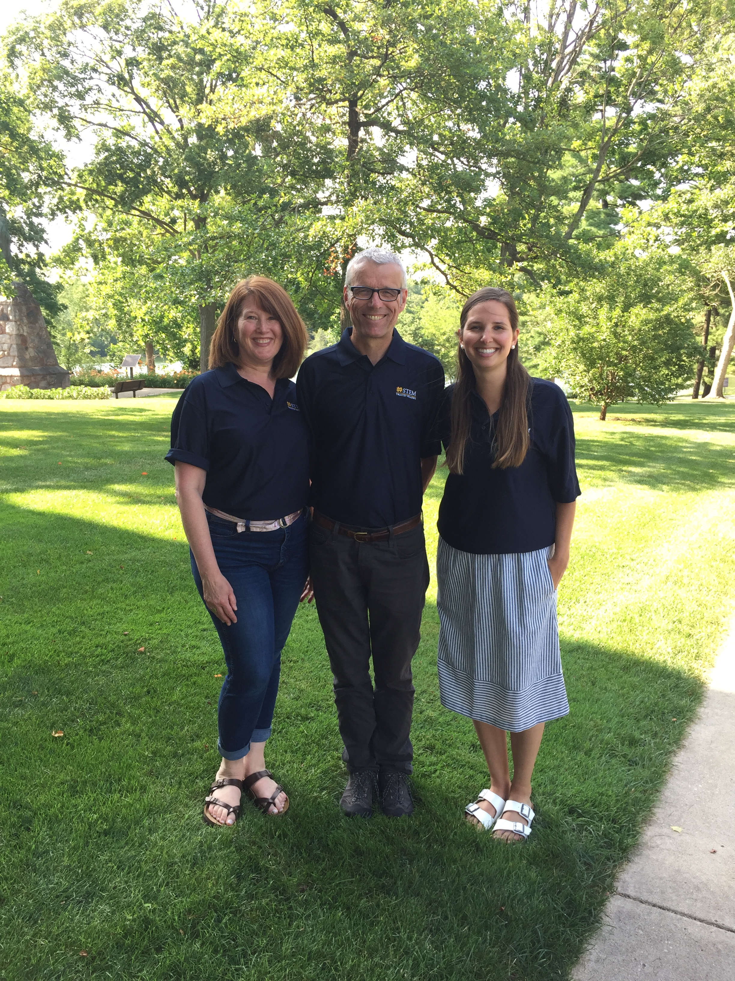
STEM Integration
GOALS:
Develop critical thinking skills
Facilitate a hands-on-learning environment
Meet the Next Gen standards by integrating Science, Technology, Engineering, and Math
Use best practices in teaching and learning
HOW?
Three fascinating, fun, fully integrated units a year
St. John’s Makerspace

Slide 12
Technology
Ipads & Laptops & chromebooks
Keyboarding: Goal 25 wpm
Word, Powerpoint, Excel, Internet Research
www.spellingcity.com

Slide 13
Grading Policy/ Evaluations
Practice Work
  Homework = effort score
  Skill work in class
  ✓scores
Evaluation Work
  Skill Mastery (quizzes, tests, projects, reports, certain indicated assignments)
  Percentage Score
Test Retakes
  Any test with a grade lower than 80% can be retaken.
  Simply have your child a Request to Retest form.
  Generally re-takes can be done either before or after school within 2 weeks of receiving the test back.
Notes:
evaluation scale
Easy grade pro

Slide 14
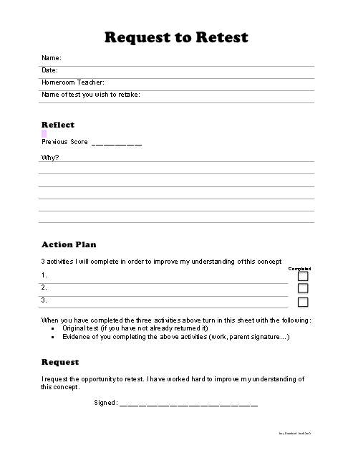
Help your child schedule test retakes

Slide 15
Homework
About 50 minutes each day
Nearly every day…
Reading
Math practice
Spelling/Vocab
Work not completed in class
Also, the occasional long-term project
.

Slide 16
HOW YOU
CAN HELP

Slide 17
  About that homework…
  Let go but be the safety net
TIPS
Initial your child’s planner each night/1st trimester
Set up a good spot to do homework
Answer quick questions only—let me see what I need to reteach
Make sure work is done and back in the folder
Check the PowerSchool parent portal for missing work once a week???
Look over returned work and sign Boomerang
Taking too long? Write a note after 50 minutes and call it a day.

Slide 18
PowerSchool Parent Portal 101
Different categories carry different weights
All scores are averaged. Beware the skewed data!
All scores read as grades (even practice work)
M = missing assignment
L= late assignment
Help your child follow up!
My NO NAME file is usually chock full!

Slide 19
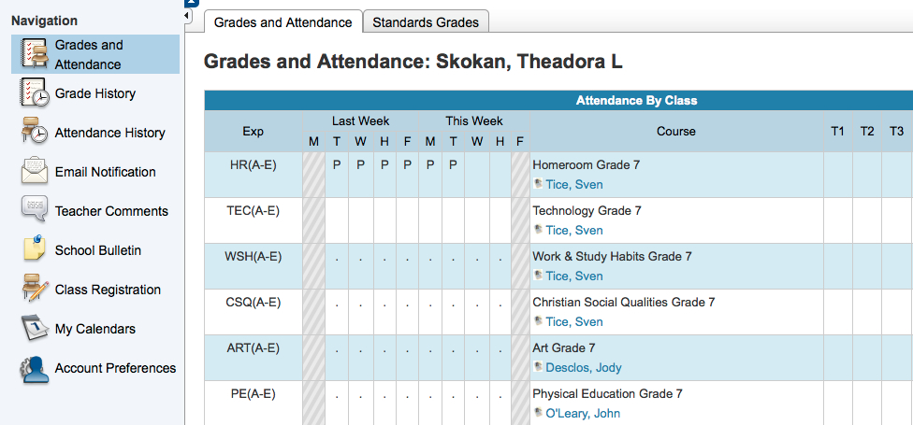
What you see on the Parent Portal…

Slide 20
Volunteers
Update your safe environment training
Room parent needed
Auction Liaison
Hospitality chair
Library helper (Friday 12:30-1:15)
Volunteer for field trips

Slide 21

Parent/Teacher/Student Communication
Parent/Teacher/Student Conferences
E-mail: kkelley@st-johnschool.org
Phone: 206-783-0337 x 346
Weekly Website updates/Teacher Page:
http://stjohnsea.org

